Slide 1
Kubernetes: Networking
VishwanaTH m s
VISHWACLOUDLAB.in

Slide 2
Agenda
Single pod networking
Pod to pod Networking(East-West traffic)
Service discovery and load balancing
External access(North-South traffic)
Network policy
Istio service mesh
Multi-cluster and hybrid cloud
Best practises

Slide 3
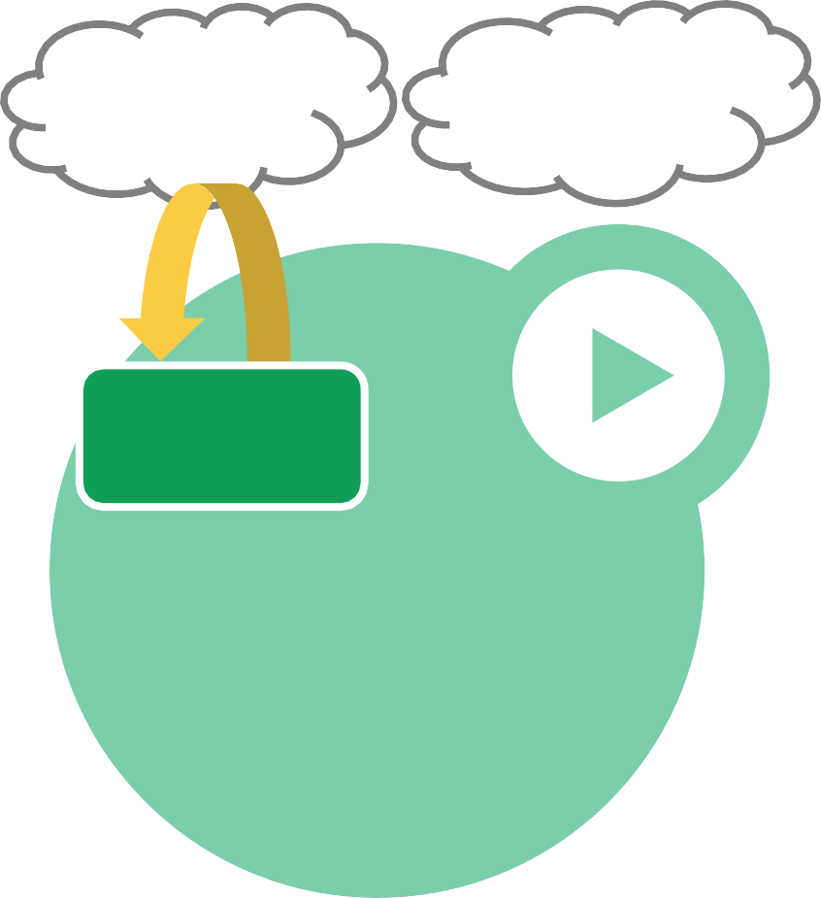

Pods
Content Manager
Consumers
Small group of tightly-coupled containers
Every pod has a unique IP
Share same namespace and volume
Share same lifecycle
Use cases for multi-container pods - Sidecars, proxies/adapters
File Puller
Web Server
Volume
Example: File puller & web server
Pod

Slide 4
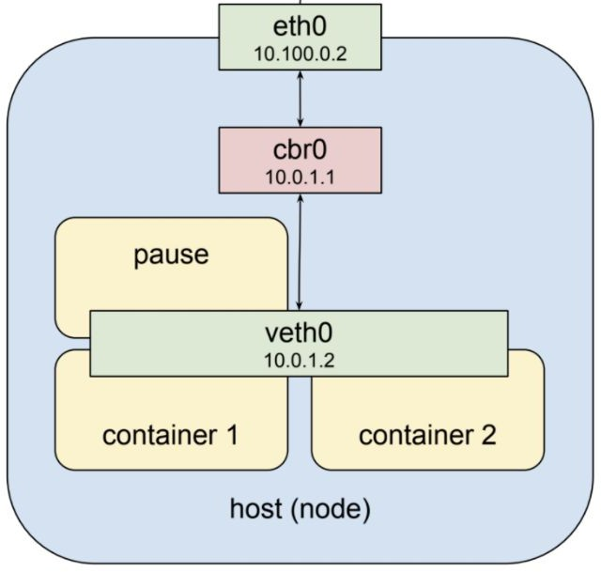
Single Pod Networking

Slide 5
Communication across pods in different nodes
Kubernetes supports different networking approaches to do pod networking
Plugins can be added using CNI
Type/Features | L2 | L3 | Overlay | Cloud
Summary | Pods communicate using L2 | Pod traffic is routed in underlay network | Pod traffic is encapsulated and uses underlay for reachability | Pod traffic is routed in cloud virtual network
Underlying technology | L2 arp, broadcast | Routing protocol like BGP | VXLAN | Pre-programmed fabric using controller(eg: GKE)
Encapsulation | No double encapsulation | No double encapsulation | Double encapsulation | No double encapsulation
Examples |  | Calico | Flannel, Weave | GKE, ACS, EKS

Slide 6
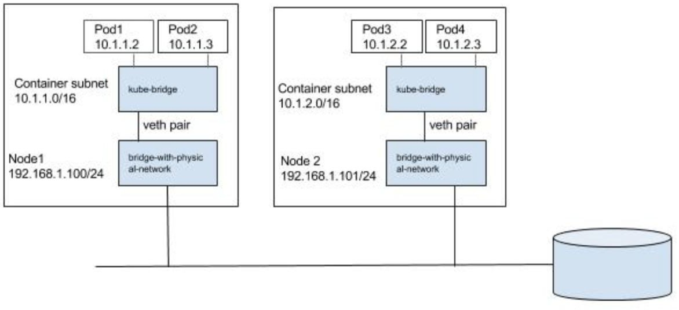
L2 approach
Notes:
Explanation of the Example
What It Shows
Two Kubernetes Nodes (Node1 and Node2), each with:
Its own container subnet (10.1.1.0/16 for Node1, 10.1.2.0/16 for Node2)
Two Pods on each node, with their own IP addresses
Each node has a physical network IP (192.168.1.100/24, 192.168.1.101/24)
Pod-to-pod networking:
Within the same node, pods communicate via a local Linux bridge (kube-bridge) and a pair of virtual Ethernet devices (veth pair)
For cross-node communication, traffic goes from pod → kube-bridge → veth pair → bridge-with-physical-network → physical network
Type of Networking
Type:
This is an example of the basic bridge (L2) or flat networking approach (used by default Docker networking and basic CNI plugins like Flannel in host-gw mode, Calico in certain modes).
Each pod gets its own IP and can communicate with any other pod in the cluster, regardless of node, provided the CNI setup allows pod subnet routing.
Key Concepts
Kube-bridge: A Linux bridge inside each node that connects pod network interfaces.
Veth Pair: Connects each pod's network namespace to the bridge.
Bridge-with-physical-network: Connects the node's bridge to the physical network interface, enabling routing between nodes.
Pod-to-Pod Communication: Works seamlessly if routing/subnets are configured correctly.
Underlying Technology: Linux networking (bridge, veth, IP routing).
Real-world Plugin Examples
Flannel (host-gw mode)
Calico (L2 or L3 mode)
Basic Docker networking

Slide 7
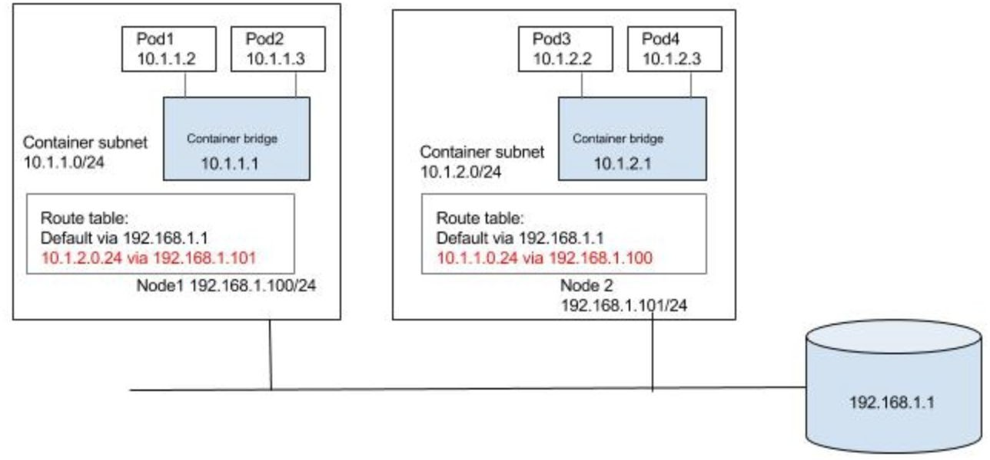
L3 approach
Notes:
This diagram shows how pod-to-pod communication works in a multi-node Kubernetes cluster using simple Linux routing. Each node knows how to reach pods on other nodes by sending traffic to the right node IP, using explicit routes in its routing table. This is the foundation of basic L3 Kubernetes networking.

Slide 8
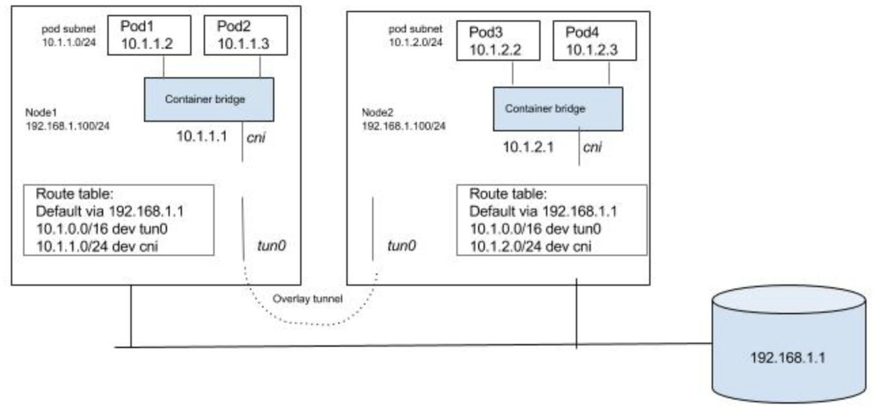
Overlay approach

Slide 9







Services
A service is a group of endpoints (usually pods) grouped by selector
Services provide a stable VIP (except Headless)
VIP automatically routes to backend pods
VIP to backend pod mapping is managed by kube-proxy, implemented using iptables
apiVersion: v1 kind: Service metadata:
name: productpage
spec: selector:
app: productpage
type: ClusterIP ports:
- port: 80
targetPort: 8080 protocol: TCP
Client
Virtual IP

Slide 10



DNS
Service Discovery achieved by CoreDNS
CoreDNS runs as a pod in the cluster
apiserver
CoreDNS
kube2Core
watch
etcd

Slide 11
Service communication
Service IP is accessible only from within the cluster
Type “ClusterIP” is used for internal communication within the cluster
Traffic sent to Service IP gets load balanced to pods that belong to service IP
Source NAT is used for pods to communicate to external world
IPtables are used extensively for load balancing and NAT
Nodeport, Network load balancer and Ingress controller are service types for external world to reach services inside the cluster.

Slide 12
Service external reachability options
Feature | Nodeport | Load balancer | Ingress
Summary | Service is exposed using a reserved port in all nodes of cluster(Default: 32000-32767) | Typically implemented as network load balancer | Typically implemented as http load balancer
IP address | Node IP is used for external communication | Each service needs to have own external IP | Many services can share same external IP, uses path based demux
Use Case | Demo purposes | L3 services | L7 services
Examples |  | GKE Network load balancer | GKE http load balancer, nginx, Istio

Slide 13
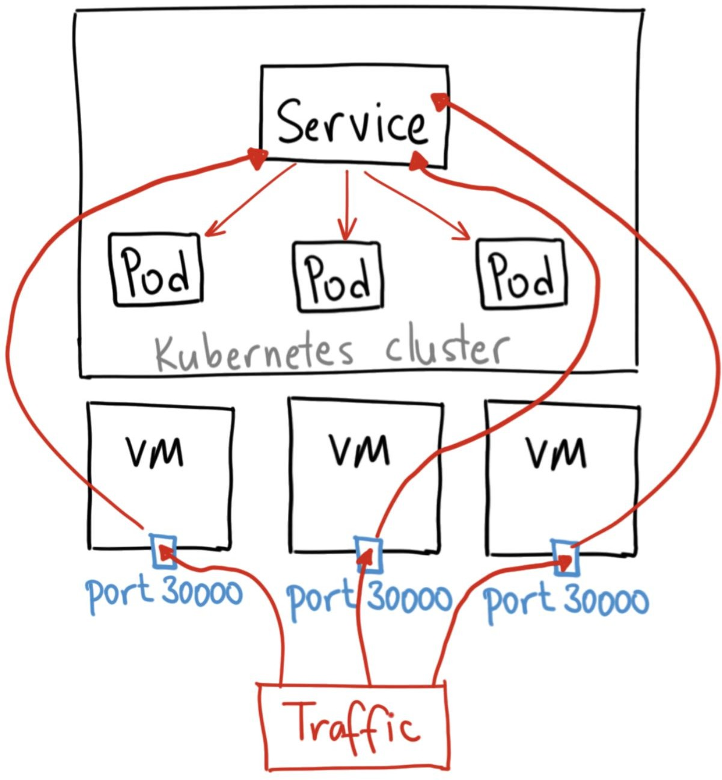
Nodeport
apiVersion: v1 kind: Service metadata:
name: productpage labels:
app: productpage spec:
type: NodePort
ports:
- port: 30000
targetPort: 9080 selector:
app: productpage

Slide 14
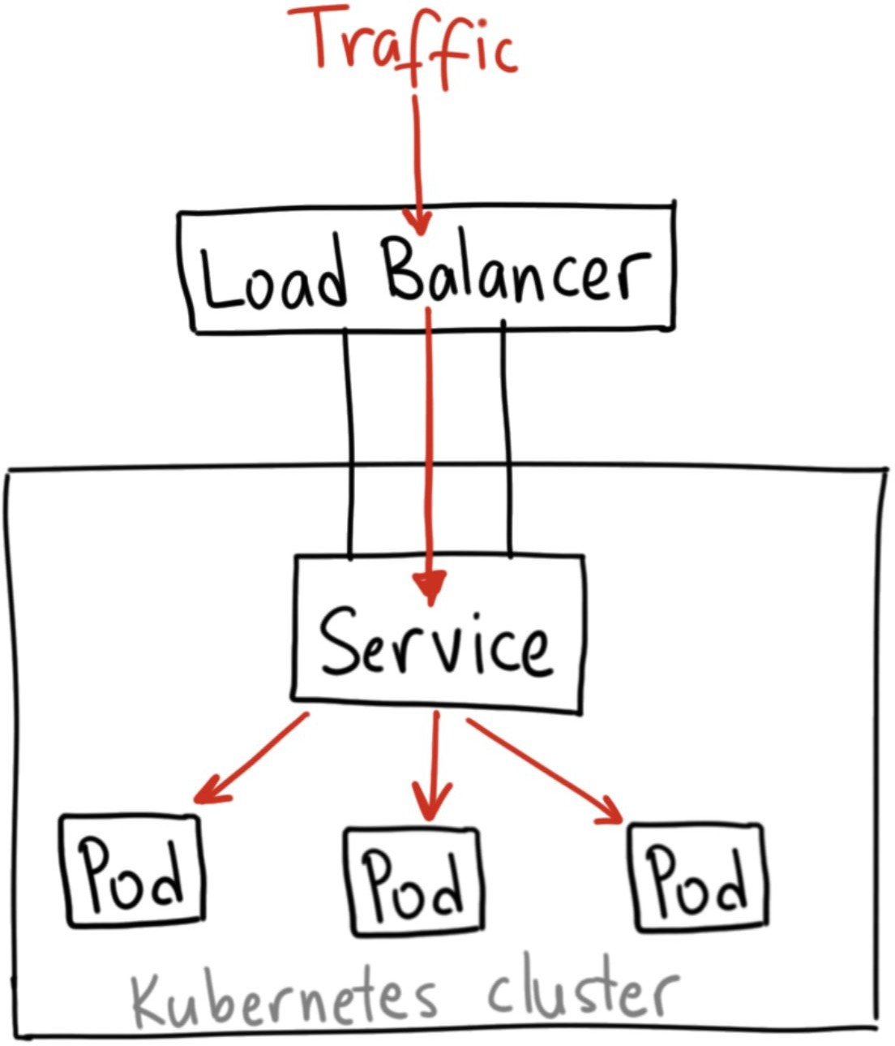
Load balancer
apiVersion: v1 kind: Service metadata:
name: productpage labels:
app: productpage spec:
type: LoadBalancer
ports:
- port: 80
targetPort: 9080 selector:
app: productpage

Slide 15
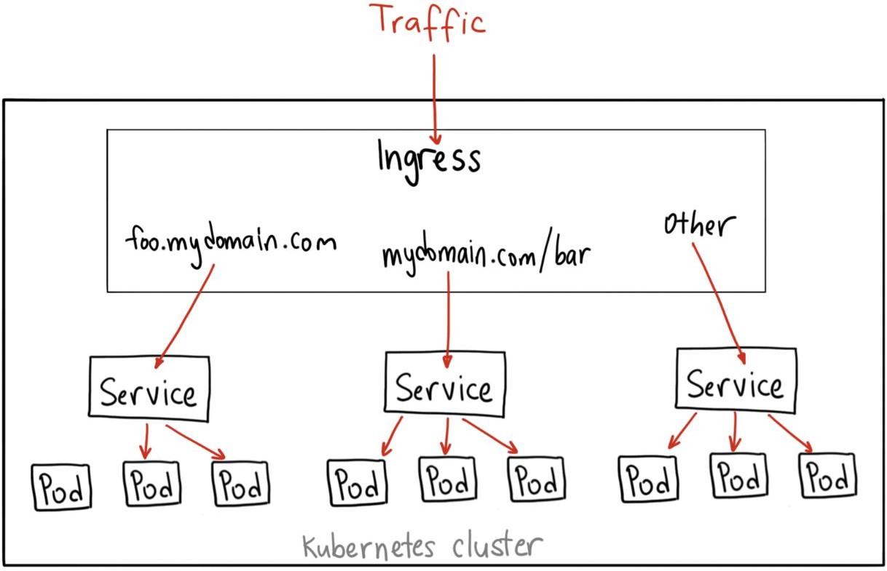
Ingress
apiVersion: extensions/v1beta1 kind: Ingress
metadata:
name: gateway spec:
backend:
serviceName: productpage servicePort: 9080
rules:
host: mydomain.com http:
paths:
path: /productpage backend:
serviceName: productpage
servicePort: 9080
path: /login backend:
serviceName: productpage
servicePort: 9080
path: /* backend:
serviceName: productpage
servicePort: 9080

Slide 16
Network control policy
Controls communication between Pods and Services
Traffic is by default allowed without network policy
Kubernetes network policies are allow policies, there is no deny policy
Empty pod selector selects all pods
Ingress and egress rules are available to control traffic
Traffic is allowed if atleast 1 policy allows traffic
Network plugins like Calico, Weavenet support network policies. GKE uses calico

Slide 17


Network control policy example1
kind: NetworkPolicy
apiVersion: networking.k8s.io/v1 metadata:
name: hello-allow-from-product spec:
policyTypes:
Ingress podSelector: matchLabels:
app: reviews ingress:
from:
- podSelector: matchLabels:
app: productpage
Product
Reviews
Details
Ratings

Slide 18
Network control policy example2
kind: NetworkPolicy
apiVersion: networking.k8s.io/v1 metadata:
name: hello-allow-from-product spec:
policyTypes:
- Ingress podSelector: matchLabels:
app: reviews ingress: []
Product
Reviews
Details
Ratings

Slide 19
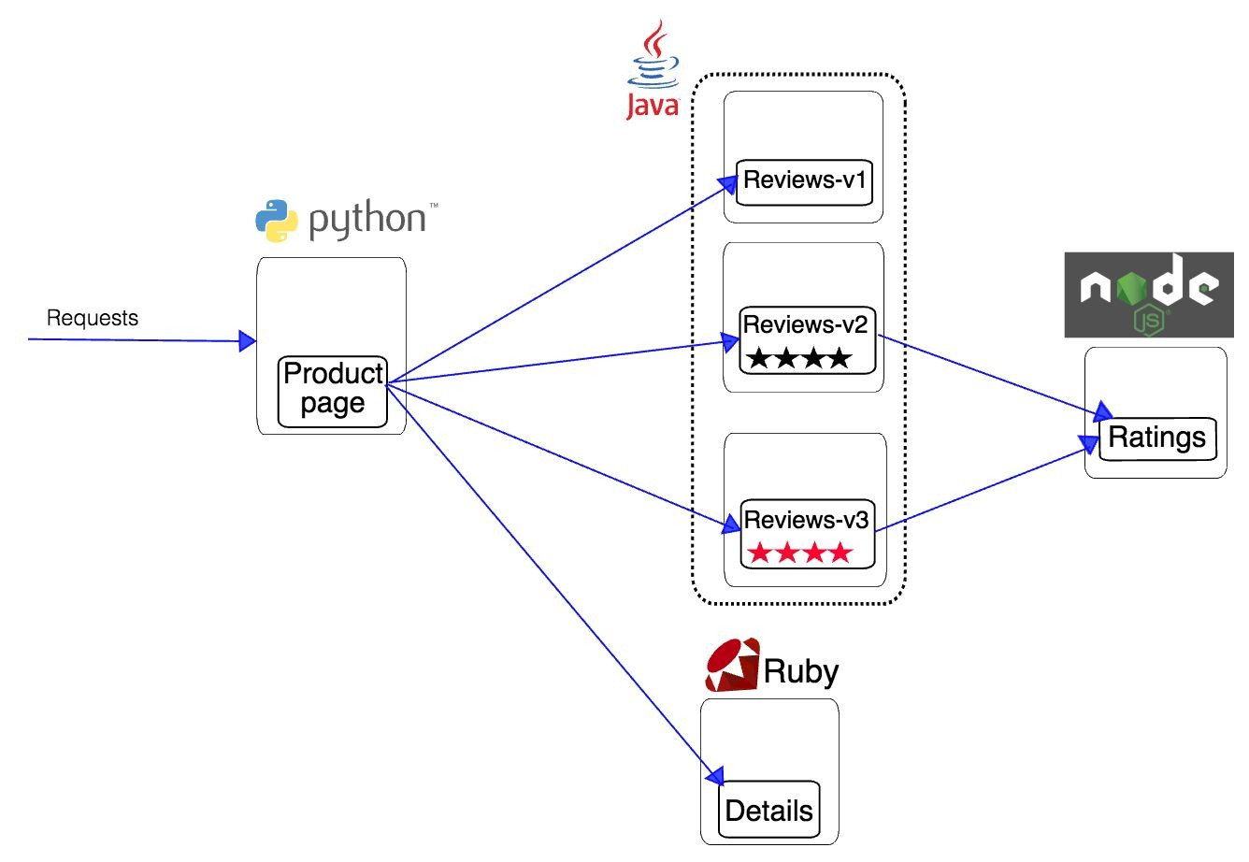
Book review App

Slide 20
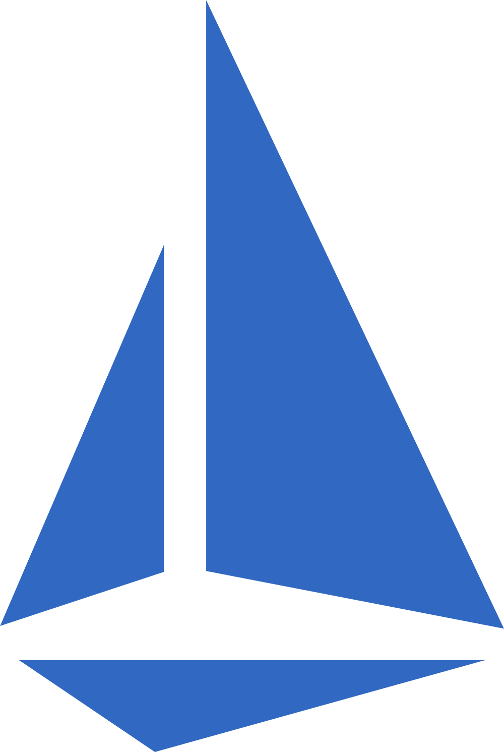

What is Istio?
Istio is an open framework for connecting, securing, managing and monitoring services
What can Istio do?
Traffic control
Observability
Security
Fault-injection
Hybrid cloud

Slide 21



Istio Architecture
Frontend
Payments
Traffic transparently proxied — unaware of proxies
Proxy
Proxy
Discovery & config data to proxies
Policy checks, telemetry
TLS certs to proxies
Pilot
Mixer
Citadel
Istio Control Plane

Slide 22
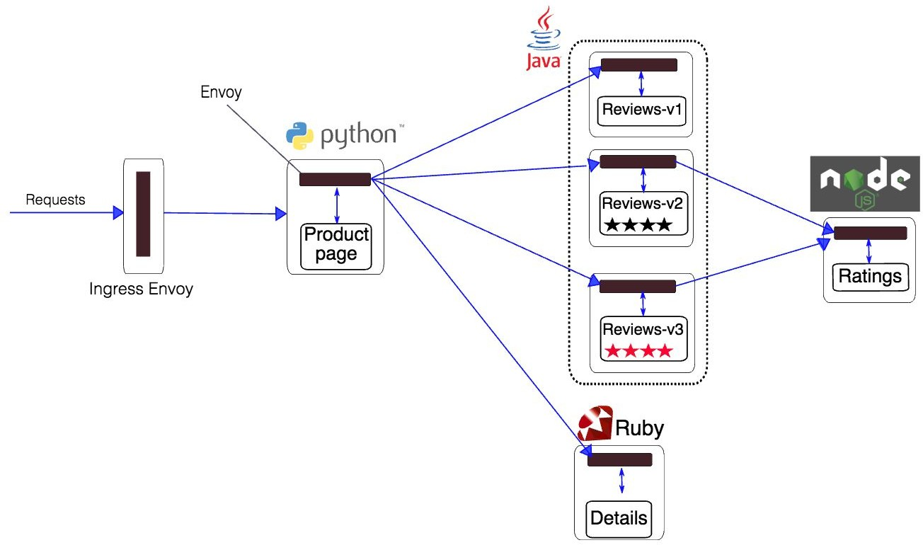
Book review App(with Istio)

Slide 23
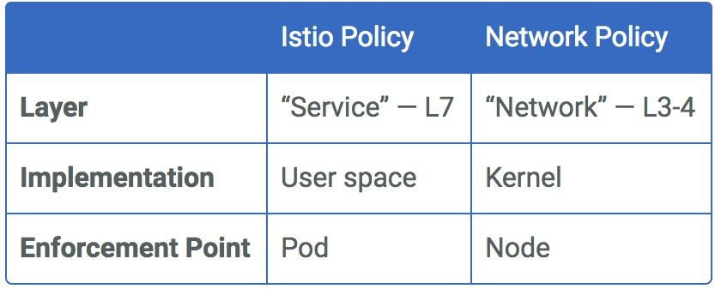
Compare Network control policy with Istio

Slide 24
Multi-cluster
Use- cases:
1 cluster serving as DR for another cluster
CI/CD between Dev and production clusters
Global load balancing across multiple clusters
Ability for 1 cluster to consume services from another cluster
Requirements:
Common control plane across clusters
Service discovery across clusters
Load balancing traffic across replicas in different clusters
Common policy management across clusters - RBAC, Quota etc

Slide 25

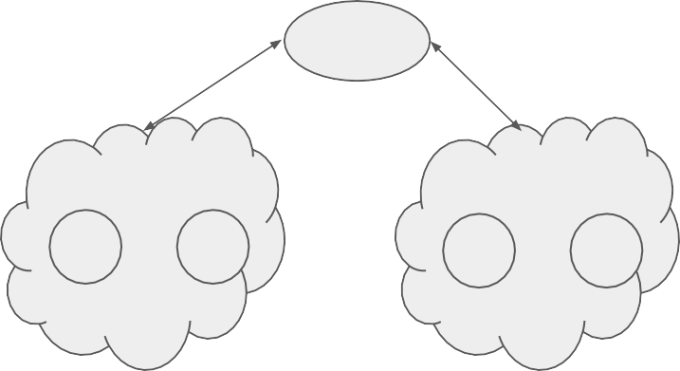


Multicluster/Hybrid cloud use cases
CI/CD
S1
S2
S1
S2
S1
S2
S1
S2
Disaster Recovery
Dev/Prod setup
LB
S3
S4
Region1
Region2
S1
S2
S1
S2
S1
S2
S1
S2
Cloud bursting Consume services across cluster
Load balance across regions

Slide 26
Multi-cluster deployment options
Kubernetes Federated cluster
Have a single Kubernetes control plane that spans multiple clusters
Controlled using Kubefed
Service discovery works across clusters
Istio Multicluster
Istio control plane that spans across multiple clusters
Kubernetes control plane limited to single cluster
Service discovery works across clusters
Istio ingress takes care of load balancing external traffic across clusters
Managed service from cloud providers (eg: GCP Cloud services platform)

Slide 27
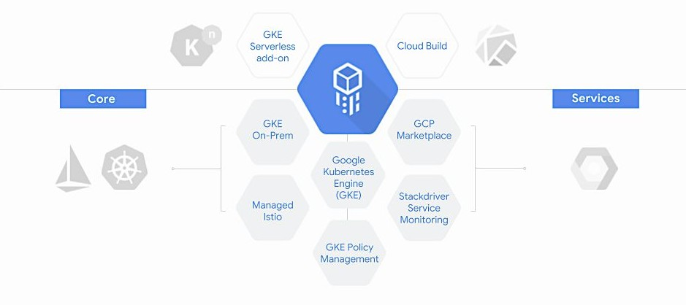
GCP Hybrid cloud Kubernetes solution

Slide 28
Kubernetes Networking - Best practises
Use namespaces for multi-tenancy
Use Ingress rather than Load balancer to expose services. This is to preserve resources
Do not expose cluster to outside world if its not needed
Create security policies like IAM, RBAC, Network control in the beginning rather than later
Put emphasis on resource control including quotas, priorities/preemption etc

Slide 29
Our Agenda
01
RBAC in Kubernetes
02
Why RBAC ?
03
Benefits of using RBAC
04
Implementing RBAC
05
Demo

Slide 30

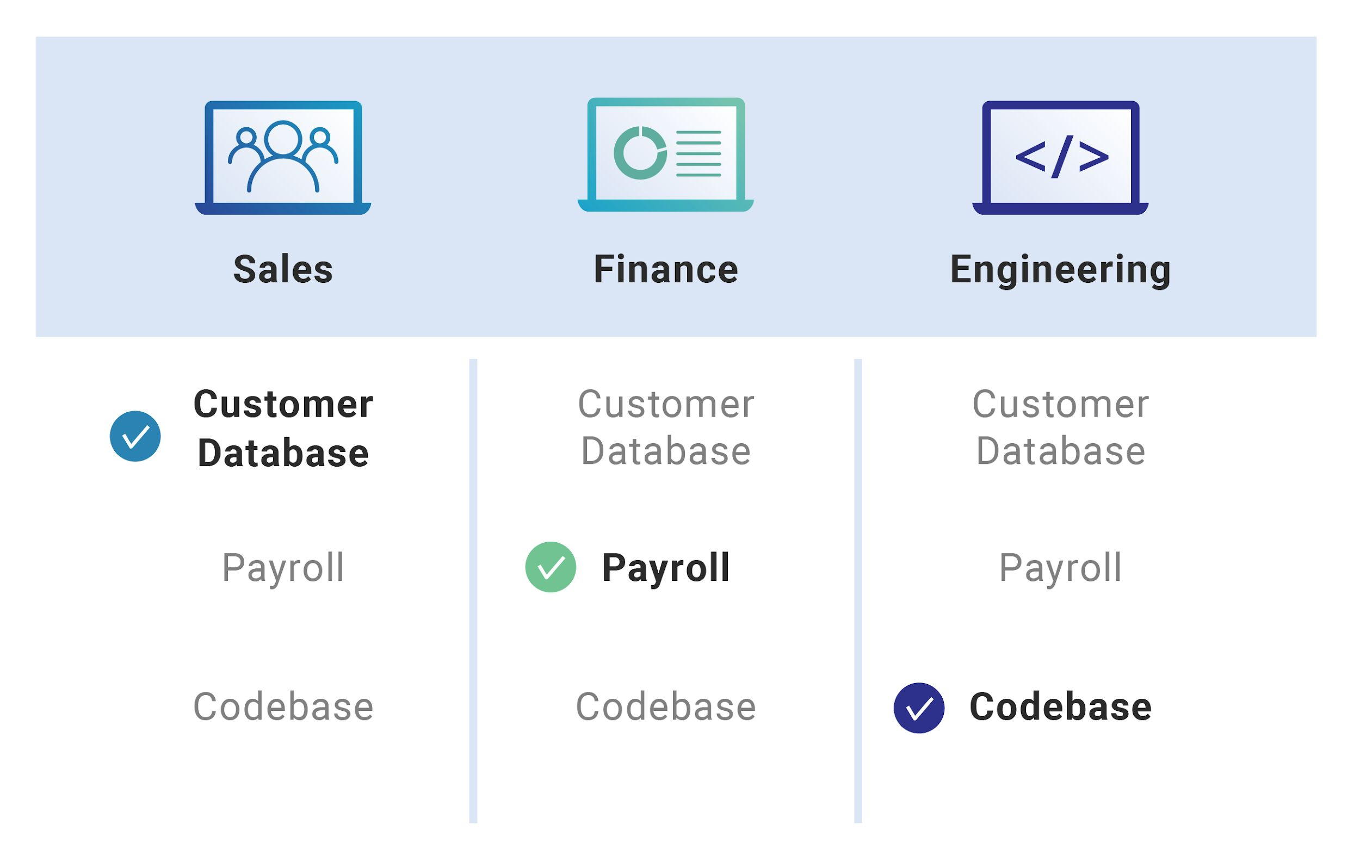
RBAC in our daily life
Roles of different individuals
Each individual in today’s world, is assigned a specific role and is expected to work in the allotted field, for example like HR, Finance, Engineering, Sales etc. without hampering the work of any other individual belonging to any other domain.
This brings out the need for some access control policy, in order to restrict the permissions allotted to a user.

